Slide 1
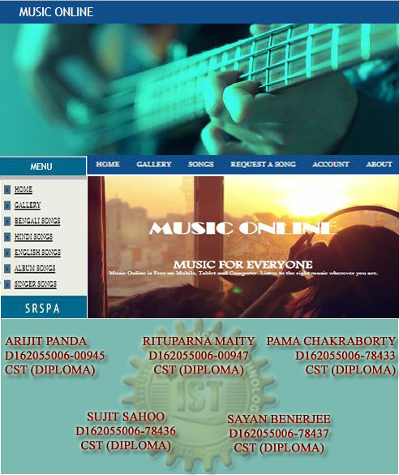

Slide 2
INTRODUCTION
“Music Online” refers to systems that will enable the user to mobilize it through uploading, playing and downloading the various music items in the website.
It will enable a visitor to have access to online browsing that is the site should be dynamic and more users centric website procedure thereby maximizing the profit of the organization.

Slide 3
EXISTING SYSTEM
Ø User has to manually visit the music shop and need to download the music item they needed.
Ø The wastage of time for searching a particular venue and a particular shop.
Ø The wastage of money as transportation for searching a particular shop.

Slide 4
PROPOSED SYSTEM
1.The proposed system uses GUI framework. This system is highly user friendly because the entire programs are menu driven so that the new comer can use the software efficiently.
2.The main intention of the proposed and designed system is to automate the downloading process between the website and the users, and easy the user work. Through this an end user can easily download the needed thing from his/her home and office or, anywhere by just clicking the mouse. And it increases the mentality of downloading.

Slide 5
ADVANTAGES OF PROPOSED SYSTEM
ØAutomate the communication between the users and the Admin.
ØSave the time of customer.
ØIt provides 24 hours of facility.
ØEveryone can access the system those who are living in any place.
➢ A guest can request a song.
ØEasy for downloading.
ØIncrease the interest about music.
ØDecrease the time wastage.

Slide 6
MODULES
• Guest module
• Member module
• Administrator module

Slide 7
GUEST MODULE
✰ New guest can visit the home page of the online music site.
✰ View gallery .
✰ Can request a song as per his/her requirement.
✰ Download any items.
✰ For uploading items, first the guest has to click the Sign Up option in the client login area.
✰ The guest must fill the registration form. The data are stored in to the database. It is not possible to leave any required data from the registration form.
✰ After that the guest becomes a member and then he/she can upload a song.
Once the system authorizes the new client, then he can perform all the functions of the registered member

Slide 8
USER MODULE
✰ First he/she has to sign in into the member interface which will help him/her to avail the services of the membership.
For the client to sign in to the system it has to provide its username and password for authorization purpose.
✰ If the username and the password match with the entry in the database then the client enters the member’s area.
✰ Then the member can song uploads songs.
✰ View gallery .
✰ The member can download song.
✰ The members can logout from the site.

Slide 9
ADMINISTRATOR MODULE
✰ Remove a particular member from the database
✰ Delete a particular song from the site
✰ Add particular item to the inventory list
✰ Modify the details regarding a particular music item
✰ Update gallery
✰ Upload a song with his choice and as per requested by a guest
✰ Download a song
✰ Login and logout as a administrator
✰ Modify and manage the total system

Slide 10
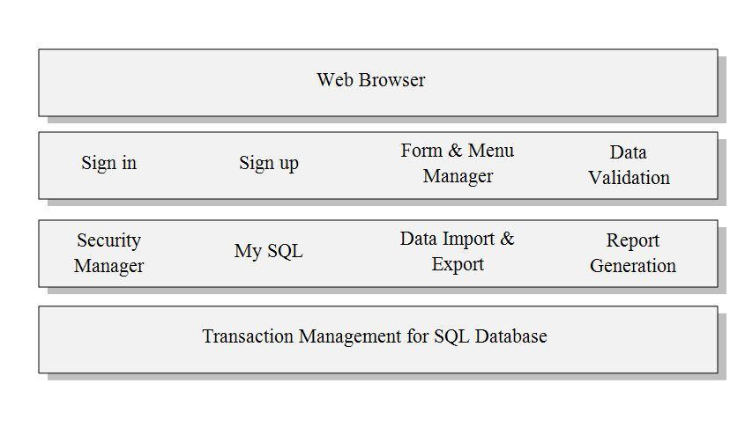
5. ARCHITECTURAL DESIGN
Figure : System Architecture For SQL

Slide 11
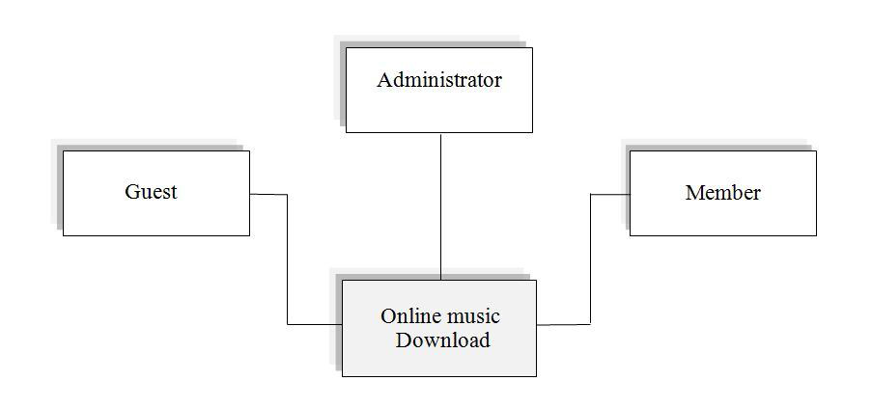
Figure : System Architecture For SQL
Figure : The Context Diagram of Online Music

Slide 12
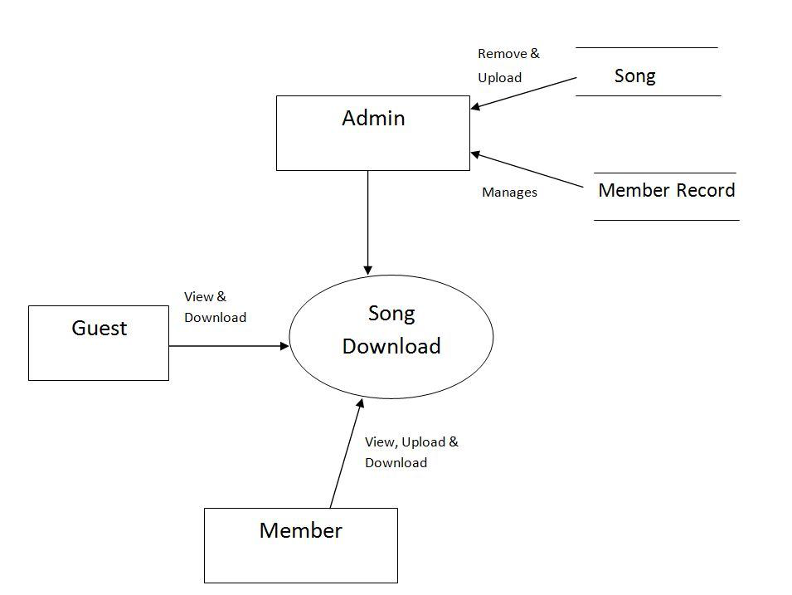
7. DATA FLOW DIAGRAM
LEVEL '0' DFD

Slide 13
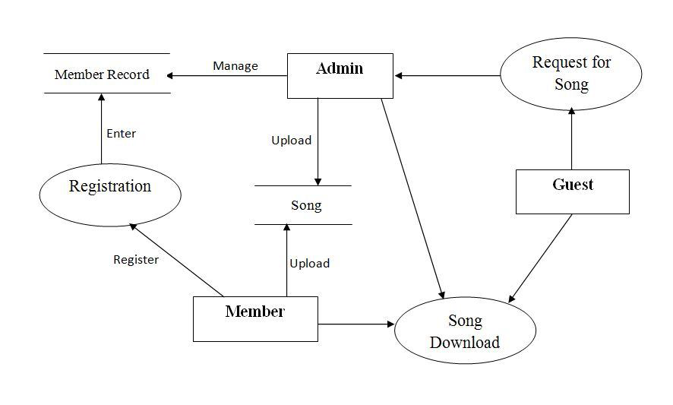
LEVEL '1' DFD

Slide 14
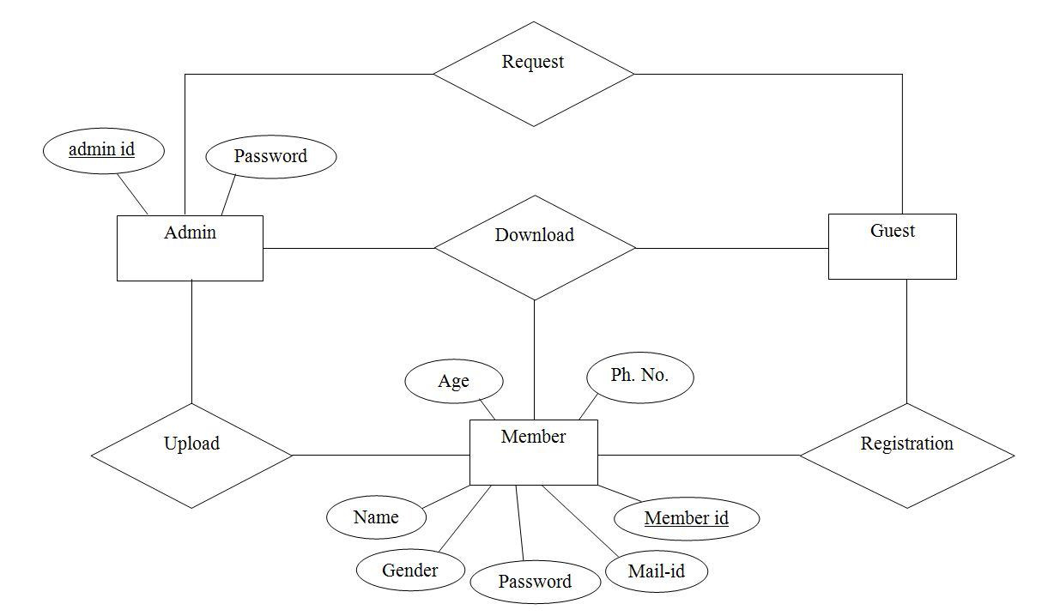
ER – DIAGRAM
Figure : ER-DIAGRAMS

Slide 15
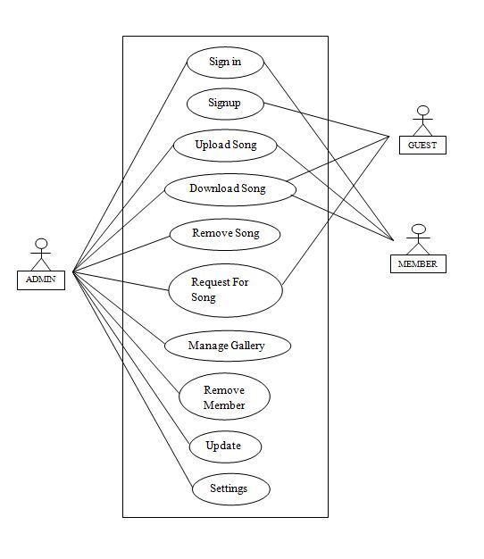
USE CASE DIAGRAM
Figure : The Basic Function of Each Actor

Slide 16
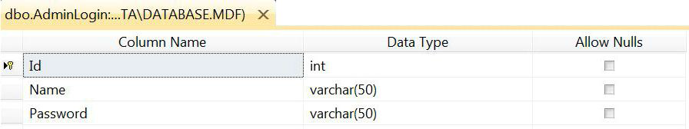
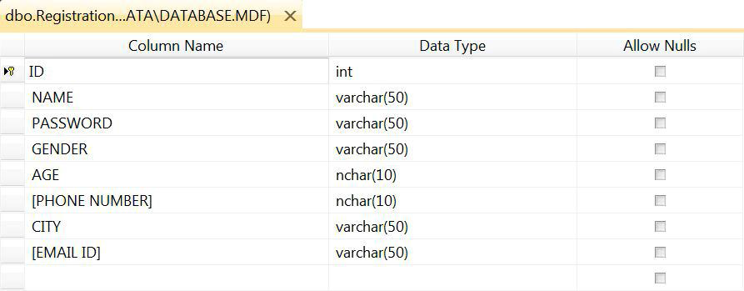
Admin Login Info Table
Registration Info Table:

Slide 17
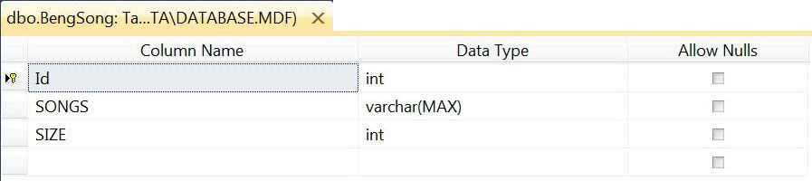
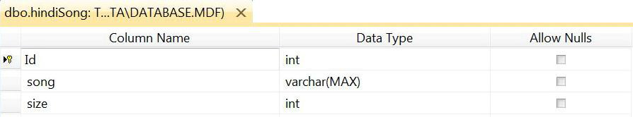
Bengali Song Info Table
Hindi Song Info Table

Slide 18
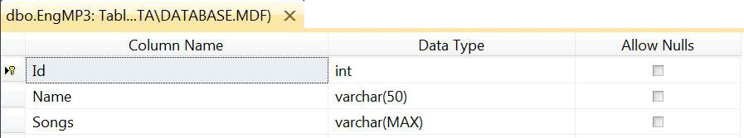
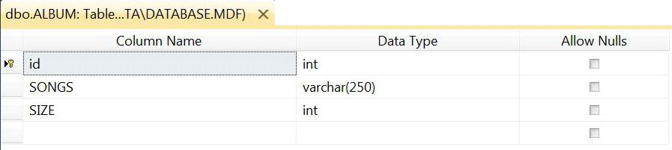
EngMp3 Info Table:
Album Info Table:

Slide 19
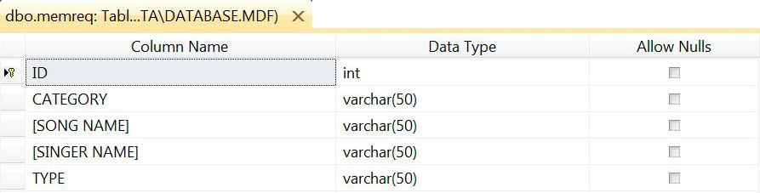
Member Req Info Table
Guest Req Info Table:

Slide 20
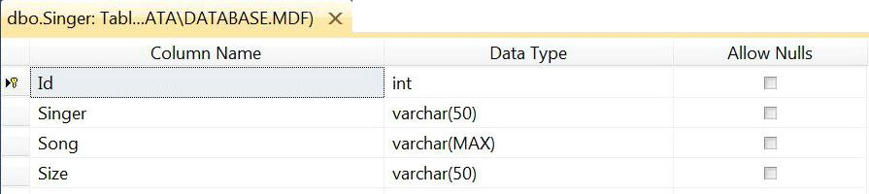
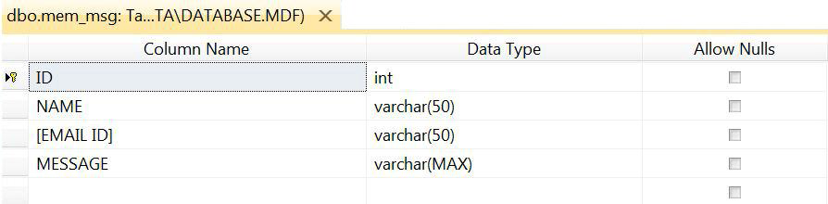
Singer Info Table:
Member Message Info Table

Slide 21
CONCLUSION
The website ‘Music Online’ reduces the considerable drawbacks like burden of human labour, portable defect and errors. This website saves time and provides 24x7 hour
accessibility even from a remote place. Programs are menu driven which help even a
newcomer to use the system with little training. Testing has been done with actual data
and system is much better than the existing one. GUI makes the interface very much user
friendly.
The system is highly user friendly and is well efficient to ease interactions with the users
of the system. Reports generate with live data are proved to be informative and also
helpful in making important decisions. The system is tested and implemented with high
degree of accuracy.
The system is done with an insight into the necessary modification that may require in
the future. Hence the system can be maintained successfully, without much rework.

Slide 22
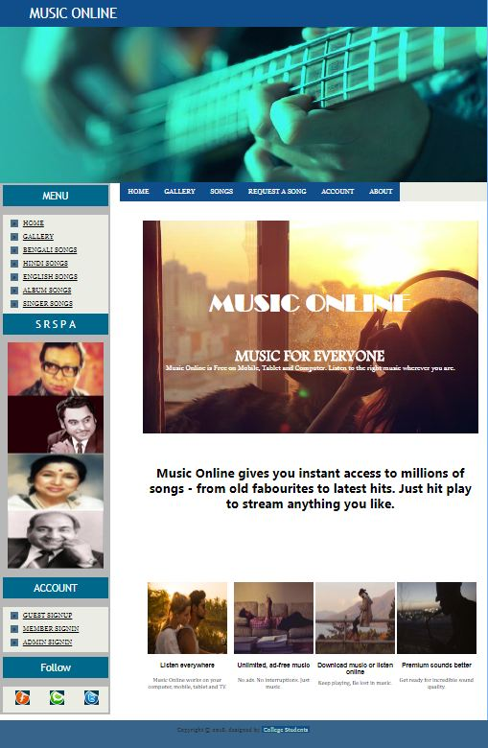

Slide 23
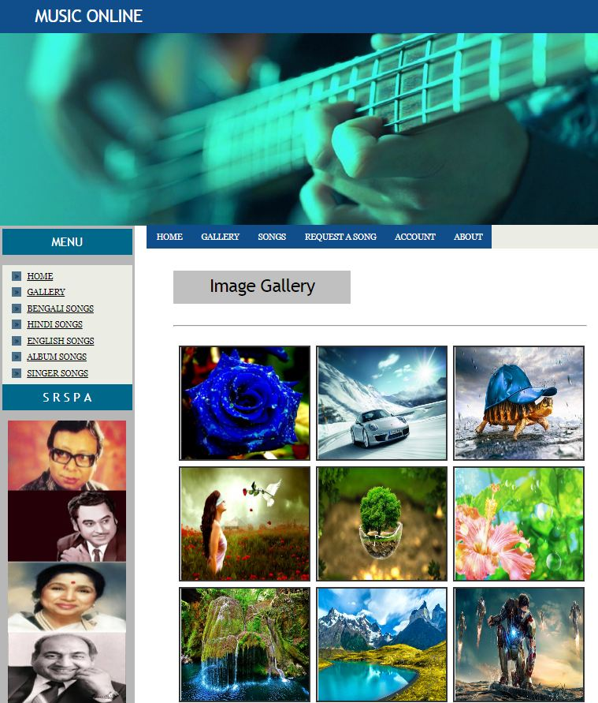

Slide 24
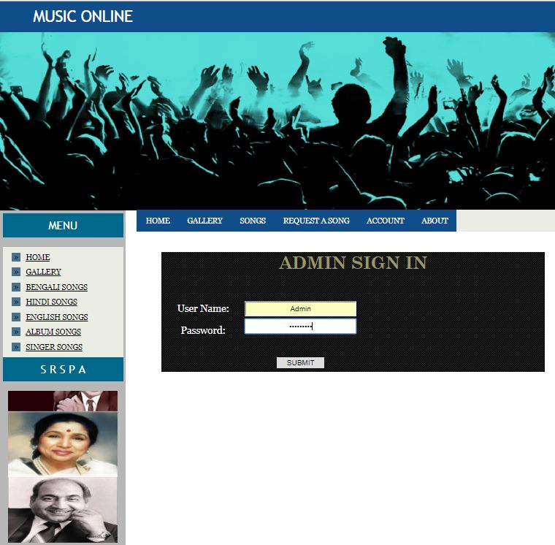

Slide 25
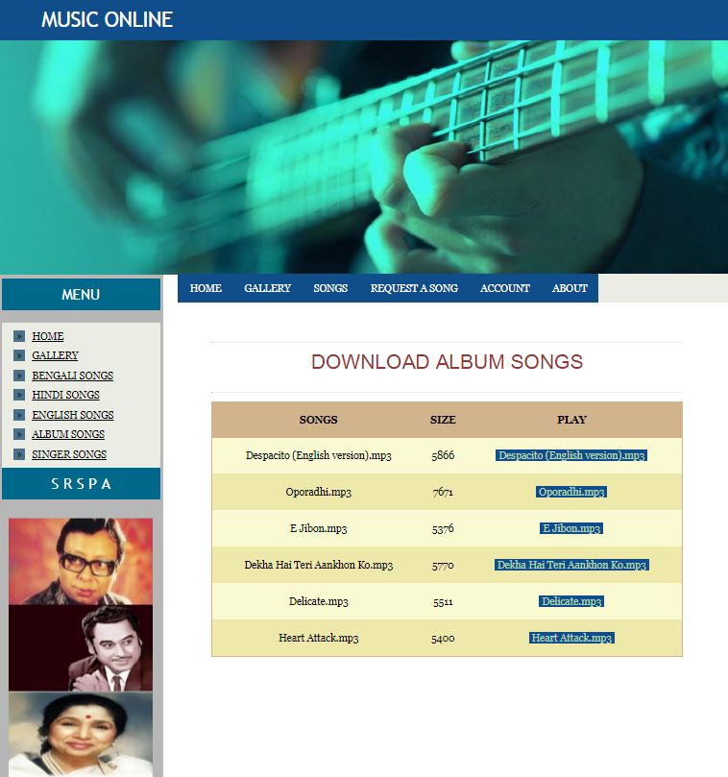

Slide 26
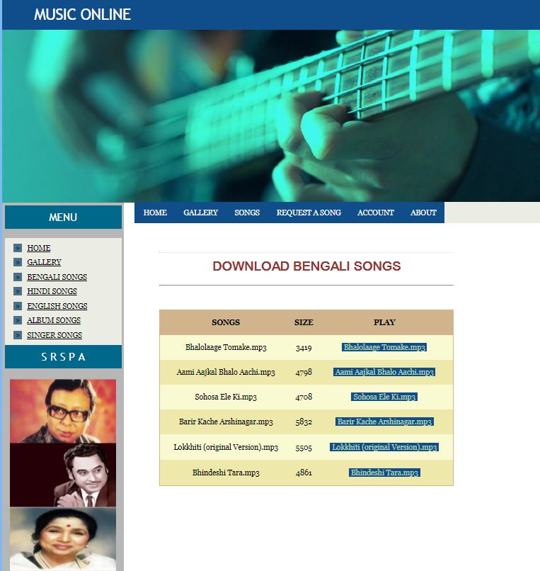

Slide 27
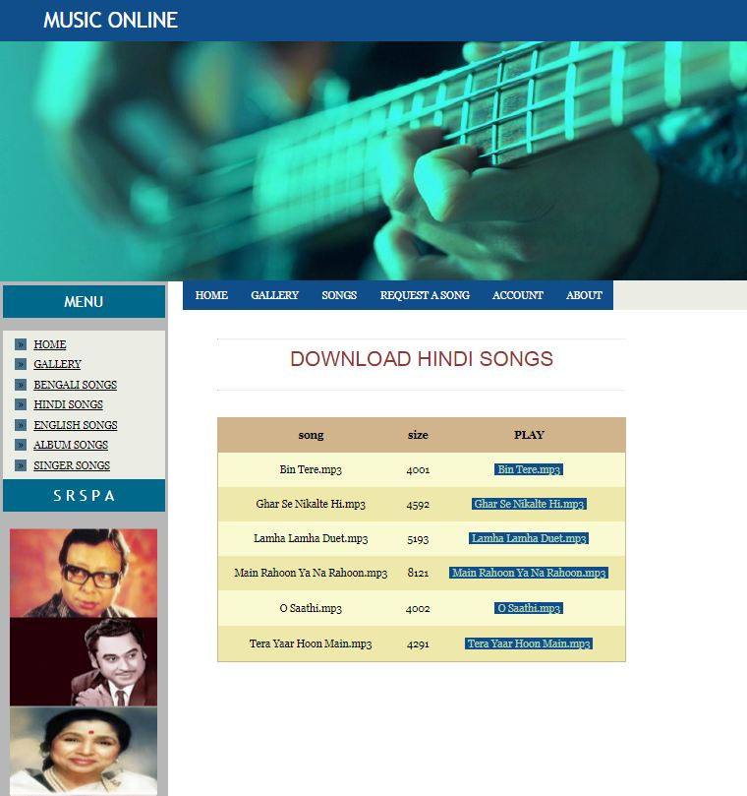

Slide 28
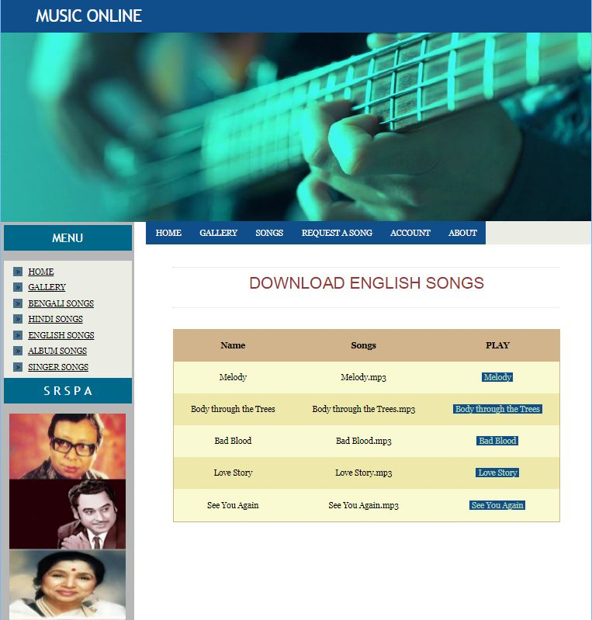

Slide 29
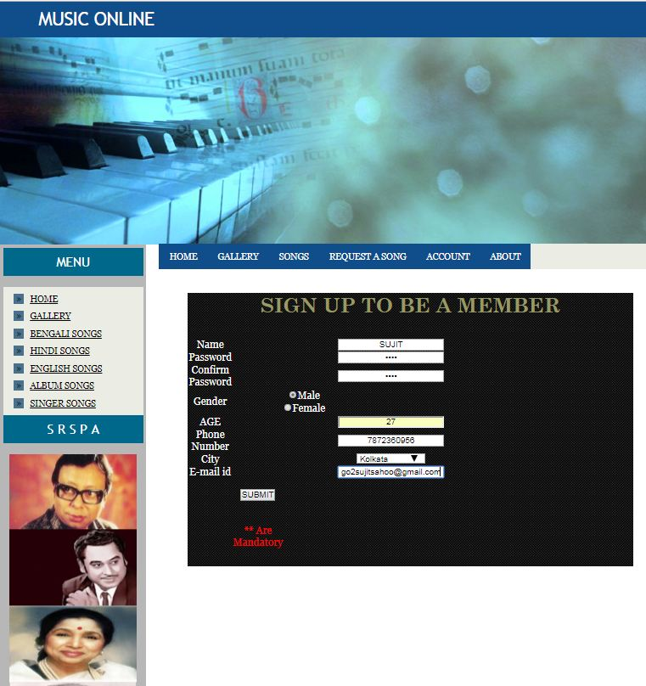

Slide 30
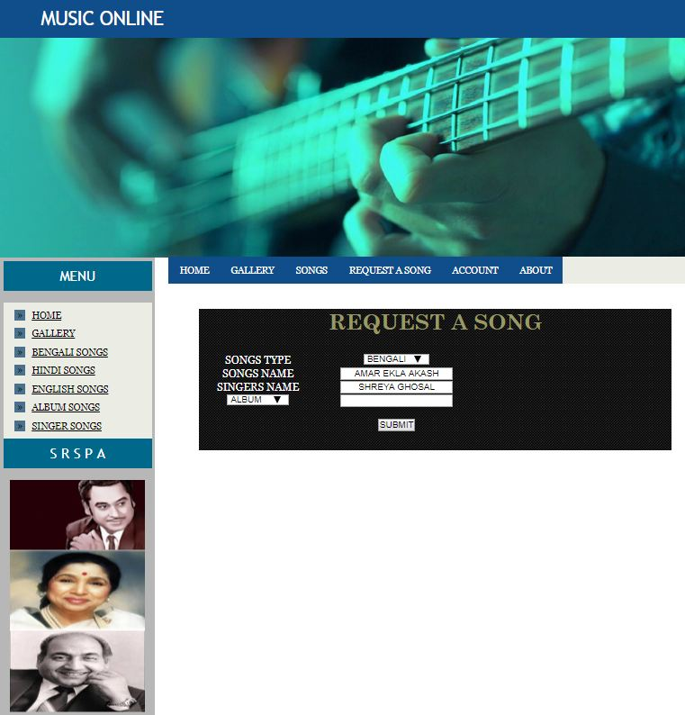

Slide 31
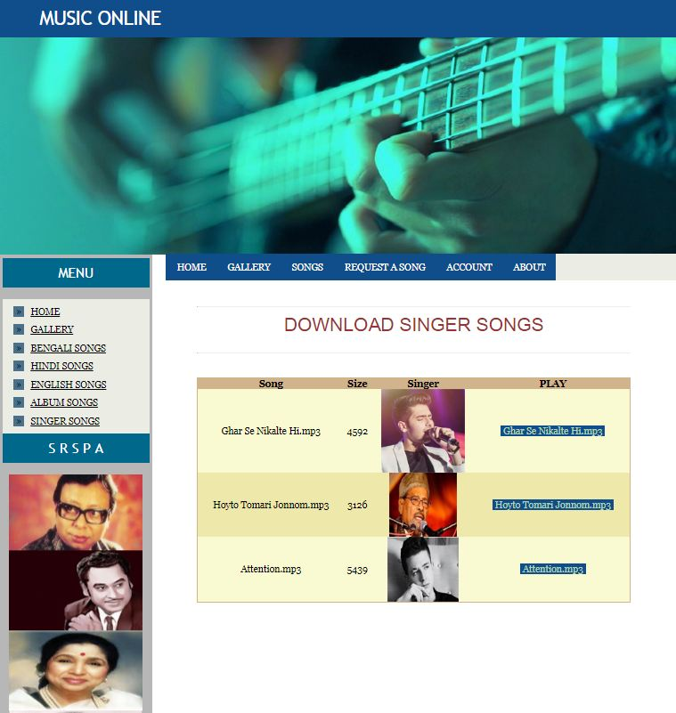

Slide 32
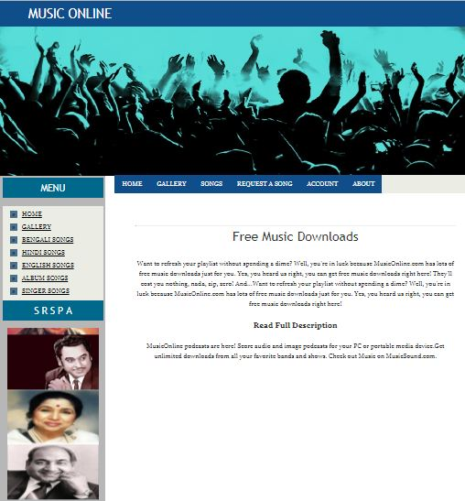

Slide 33
SCOPE FOR FUTURE ENHANCEMENT
The system ‘MUSIC ONLINE’ will fulfil the entire requirement of the clients. The
system is developed according to the present requirements of the listeners. The system is
developed as easy as possible for the sake of end users.
One drawback of our system is that the client cannot search music items by the keywords
according to particular language option. By the next time we would like to add this
facility.
By the next time we would like to add two more items, the notification bar, where the
important messages will show to the users. And the help page, from where the users can
get help by reading help tips.
As the system will be growing by the time, we would like to add one more page, new
releases, so the users don’t have to go pages to pages to get a new released song. They
can get them easily just by clicking one button.
The developed software for the organization is flexible and it can be made to run on all
kinds of platforms. The system is error free and highly portable. It can be implemented in
any servers in the Internet providing an easy access to the clients. It also has more
options of the future developments.

Slide 34
BIBLIOGRAPHY
A lot of Information had to be gathered before proceeding with the project. A
number of books, user manuals, e-books, case-studies and websites have been used while
creating this project. Here is a brief list of the materials and sites.
➢ ASP.NET 2.0 Unleashed by Stephen Watther
➢ Beginning ASP.NET 2.0 in C# by Mathew MacDonald
➢ 250 HTML web design secrets by Mollye Holzschlag
➢ http://www.google.com
➢ http://www.ebooksspyder.com
➢ www.codeworld.com
➢ www.w3c.com
➢ www.yahoo.com
➢ www.indiainfoline.com

